Slide 1
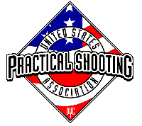
Stage 1 Pickup Sticks Course Designer: Jordan Rogers
Pickup Sticks is a 27 round, 135 point Comstock Long Course. There are 11 USPSA targets and 5 steel targets. The best two hits per target will score. Steel must fall to score. The start signal is audible.
The start position is standing anywhere completely outside the shooting area, heels touching any fault line. Handgun is loaded and holstered. PCC is loaded, stock on belt, muzzle pointing down range.
On the audible start signal, engage all targets from within the shooting area. The walls constructing the Cooper Tunnel extend to infinity. See rule 2.2.3.4. Per 10.2.5, a competitor who disturbs one or more piece of the overhead material in the Cooper Tunnel will receive one procedural penalty for each piece which falls during the course of fire. Overhead material which falls as a result of the competitor bumping or striking the uprights, or as a result of muzzle gases or recoil, will not be penalized. All barrels are soft cover.

Slide 2
 | Renton Fish and Game Bay 1 Pickup Sticks Course Designer: Jordan Rogers

